Slide 1



Course: Image Processing 31651 Assignment #21 Pixel to Pixel Operations (Part 1)
Photo of the student | Shorten Name | ID (4 last digits)
 | shienfeld | 1950 | Student #1
 | pony | 2210 | Student #2
 | akimov | 7939 | Student #3
Photo of the student | Shorten Name | ID (4 last digits)
 | shienfeld | 1950 | Student #1
 | pony | 2210 | Student #2
 | akimov | 7939 | Student #3

Slide 2
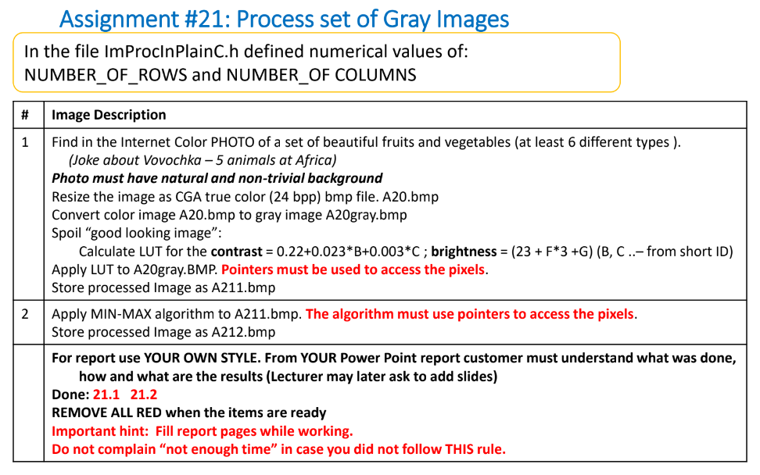

Slide 3

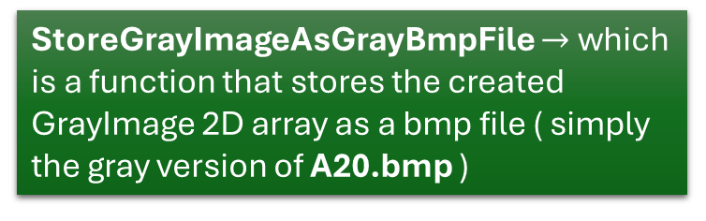
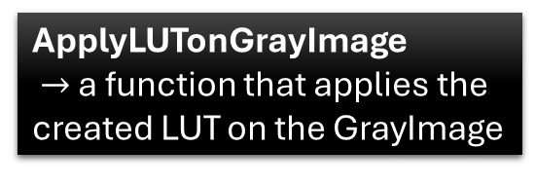
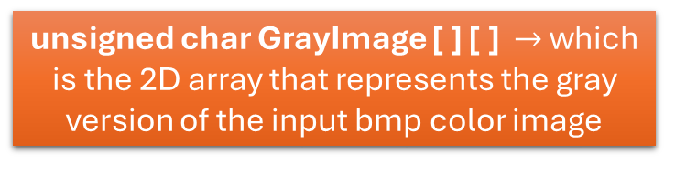
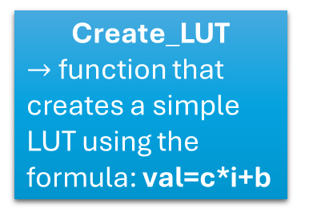

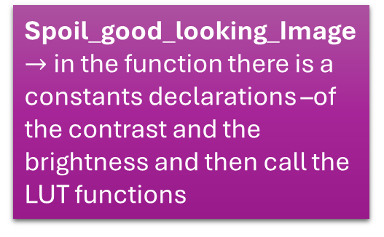
21.0 - flow chart of the code
Input : A20.bmp (320x240 dimensions and from CGA true-color (24 bpp) bmp file type)
LoadGrayImageFromTrueColorBmpFile
StoreGrayImageAsGrayBmpFile $→$ which is a function that stores the created GrayImage 2D array as a bmp file ( simply the gray version of A20.bmp )
unsigned char GrayImage [ ] [ ] $→$ which is the 2D array that represents the gray version of the input bmp color image
Min_Max_Algorithm $→$ in the function there is a constants declarations –of the contrast and the brightness and then call the LUT functions (different constants from Spoil_good_looking_Image)
Create_LUT
$→$ function that creates a simple LUT using the formula: val=c*i+b
ApplyLUTonGrayImage
$→$ a function that applies the created LUT on the GrayImage
Spoil_good_looking_Image $→$ in the function there is a constants declarations –of the contrast and the brightness and then call the LUT functions
StoreGrayImageAsGrayBmpFile $→$Store the new GrayImage as a bmp file (after transformation using LUT)

Slide 4
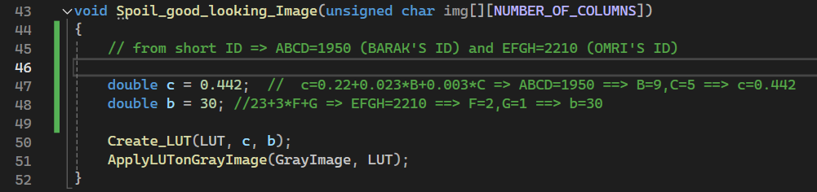
21.1 – “Spoil_good_looking_Image” function
Pay attention to ‘c’ and ‘b’ values – corresponding the IDs of the group
After ‘c’ and ‘b’ declarations – create using them a simple LUT and then apply the LUP on the gray image (img [ ] [ ] )

Slide 5
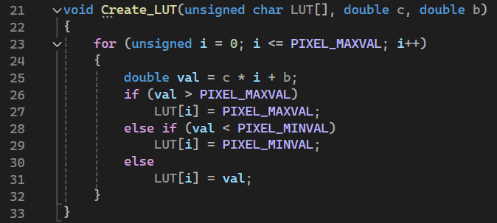
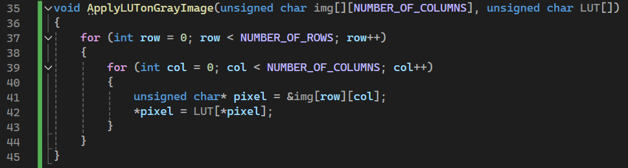
21.2 – “Create_LUT” and “ApplyLUTonGrrayImage” functions
Create_LUT is a very simple function for creating a LUT using the contrast (c) and brightness (b) constants.
After defining the LUT – we need to apply the LUT of the original gray image (img [ ] [ ] )

Slide 6
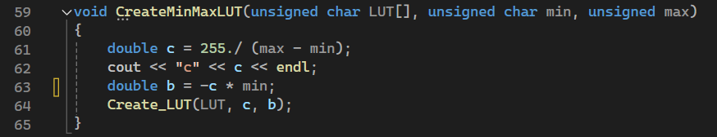
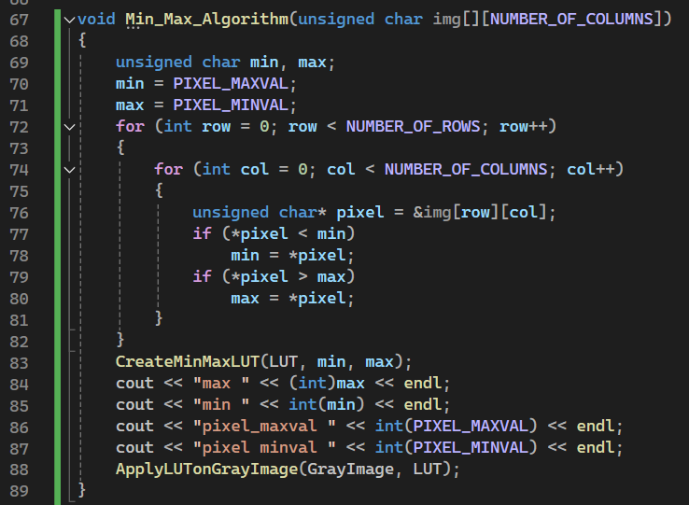
21.3 – “CreateMinMaxLUT” and “Min_Max_Algorithm” functions
Another LUT creation function – now for the min_max_algorithm.
The max value is 255 and the min value is 0 (in grayscale). Now, the ‘c’ and the ‘b’ are defined differently then they were defined for the Spoil_good_looking_Image algorithm
The first part of the function finds the minimum and maximum pixel values in the image.
min is initially set to the maximum possible pixel value (255), and max is set to the minimum possible pixel value (0).
The function then iterates through each pixel in the image. For each pixel : If the pixel value is less than min, min is updated to this pixel value. If the pixel value is greater than max, max is updated to this pixel value.
By the end of these loops, min holds the smallest pixel value in the image, and max holds the largest pixel value.
After finding the minimum and maximum pixel values, the function creates a LUT to normalize the pixel values.
Finally, the LUT is applied to the image to adjust the pixel values.

Slide 7
Introduction to profiles part of the report (parts 21.4 – 21.12)
In the next slides we will present the analysis of the results using the profiler tool – rows and columns.
We decided to present two sets of points with their profiles
Pay attention:
in all the profiles presentations row view is in the right hand side and column view is in the left hand side
Parts 21.4 - 21.7 will deal with point (152,157) to present the profiles of the 4 versions of the image
Parts 21.8 - 21.12 will deal with point (48,279) to present the profiles of the 4 versions of the image

Slide 8
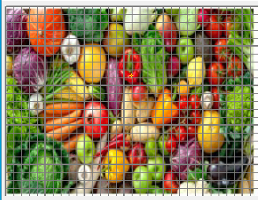
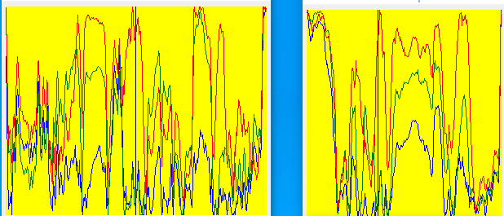
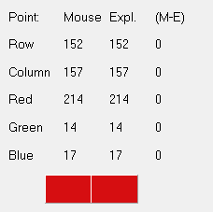
21.4 – original color image and its profiles (row and column) – for a certain point (152,157)
location
A20.bmp (original color image)
This point appears to be a bright red color, given the high red value and low green and blue values.
RGB values
Row Profile (Row = 152):
The red, green, and blue profiles along row 152 show significant variation. The red channel shows multiple peaks, indicating areas with high red intensity. The green and blue channels are generally lower, with occasional peaks corresponding to different colors in the image.
Column Profile (Column = 157):
The column profile also exhibits significant variation in all three channels. The red channel again shows prominent peaks, corresponding to red objects in the image. The green and blue channels show lower values, consistent with the overall color distribution.

Slide 9
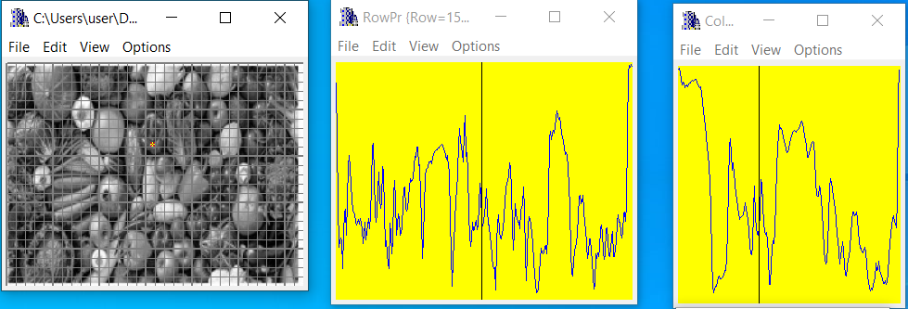
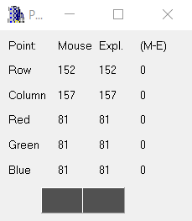
21.5 – A20gray.bmp image and its profiles (row and column) – for a certain point (152,157)
A20gray.bmp
This point has a moderate grayscale intensity, indicating it is neither very bright nor very dark.
location
Row Profile (Row = 152):
The profile for row 152 shows significant variation, but with a single color channel (grayscale). There are several peaks and valleys, suggesting areas of varying intensity along this row. The overall intensity variation is smoother compared to the RGB profiles due to the single channel representation.
Column Profile (Column = 157):
Similar to the row profile, the column profile shows varying intensity values. Peaks and valleys in the profile indicate changes in intensity along this column.
RGB values

Slide 10
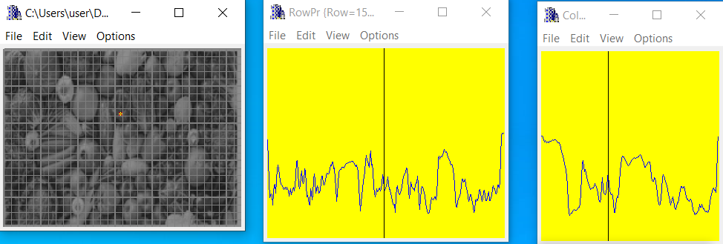
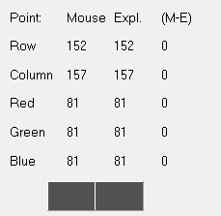
21.6 – A211.bmp image and its profiles (row and column) – for a certain point (152,157)
A211.bmp
This value remains the same as the previous grayscale image ("A20gray"), indicating the LUT transformation didn't affect this particular pixel's value.
RGB values
location
Column Profile (Column = 157):
The column profile follows a similar pattern to the row profile, showing varying intensity values. Peaks and valleys indicate changes in intensity along this column, which could be enhanced or diminished based on the LUT transformation.
Row Profile (Row = 152):
The row profile shows similar variations to the previous grayscale image ("A20gray"), but the intensity changes may appear more pronounced or compressed depending on the LUT applied. Peaks and valleys indicate regions of varying intensity, but overall the shape of the profile remains consistent with previous observations.

Slide 11
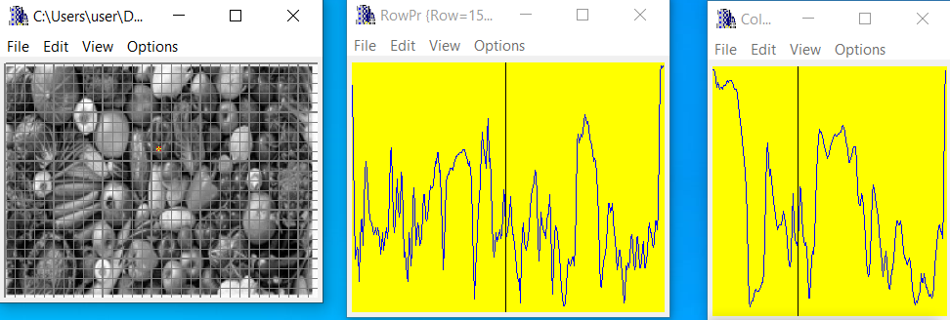
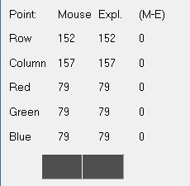
21.6 – A212.bmp image and its profiles (row and column)
– for a certain point (152,157)
The grayscale value is slightly lower than the previous value of 81, indicating some adjustment due to the Min-Max algorithm.
A212.bmp
RGB values
location
Column Profile (Column = 157):
The column profile follows a similar pattern to the row profile, showing varying intensity values.The Min-Max algorithm likely increased the contrast, making the transitions between different intensity levels more noticeable.
Row Profile (Row = 152):
The row profile shows significant variation, similar to the previous grayscale images. Peaks and valleys indicate regions of varying intensity along this row. The adjustments due to the Min-Max algorithm might have made some intensity changes more pronounced.

Slide 12
21.7 – comparison of the results – for a certain point (152,157)
A201gray.bmp
Original gray image (without further manipulation)
(81,81,81)=R,G,B
A2111.bmp
With spoiled_Image algorithm
Both for the point (152,157)
(81,81,81)=R,G,B
A2121.bmp
With min_max_algorithm
(79,79,79)=R,G,B

Slide 13
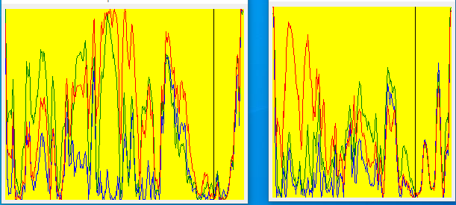
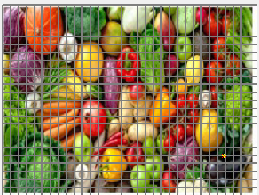
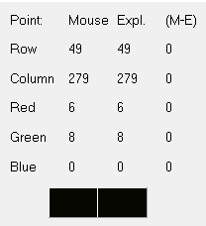
21.8 – original color image and its profiles (row and column) – for a certain point (48,279)
location
A20.bmp (original color image)
This point appears to be very dark, primarily composed of green with a slight amount of red.
RGB values
Row Profile (Row = 48):
The red, green, and blue profiles along row 49 show significant variation. The red channel shows multiple peaks, but overall lower values compared to the green channel. The green channel has higher peaks, indicating areas with higher green intensity. The blue channel is consistently low, which corresponds to the chosen point's low blue value.
Column Profile (Column = 279):
The column profile also exhibits significant variation in all three channels. The red channel shows lower values with occasional peaks. The green channel shows more pronounced peaks, reflecting higher green intensity areas. The blue channel is mostly low, consistent with the overall color distribution at the chosen point.

Slide 14
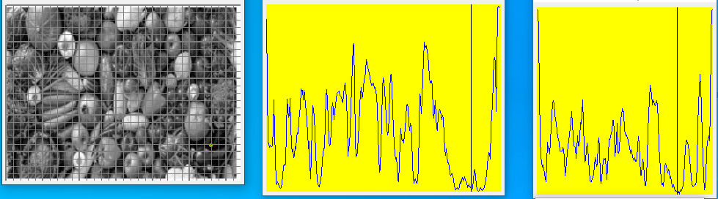
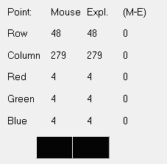
21.9 – A20gray.bmp image and its profiles (row and column) – for a certain point (48,279)
A20gray.bmp
This point is very dark, consistent with the low color values in the RGB image.
RGB values
location
Row Profile (Row = 48):
The profile for row 49 shows significant variation in intensity values. Peaks and valleys indicate regions of varying intensity along this row, but the overall intensity is lower compared to the original RGB profile. The grayscale profile is smoother and less complex than the RGB profile due to the single channel representation.
Column Profile (Column = 279):
The column profile follows a similar pattern to the row profile, showing varying intensity values. The peaks and valleys indicate changes in intensity along this column, similar to the row profile.

Slide 15
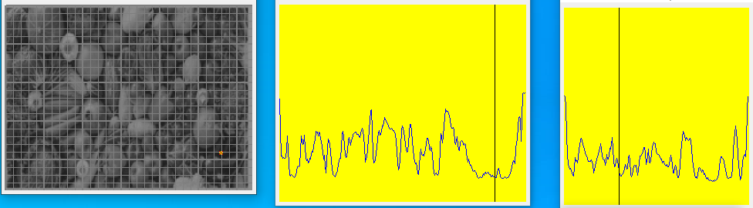
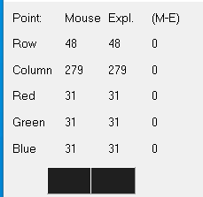
21.10 – A211.bmp image and its profiles (row and column) – for a certain point (48,279)
A211.bmp
This value is higher than the previous grayscale value of 4, indicating the LUT transformation has increased the intensity at this point.
location
Row Profile (Row = 48):
The profile for row 49 shows significant variation in intensity values. Peaks and valleys indicate regions of varying intensity along this row. The overall intensity is higher compared to the original grayscale profile. The LUT transformation has adjusted the intensity values, making the variations more pronounced.
Column Profile (Column = 279):
The column profile follows a similar pattern to the row profile, showing varying intensity values. The peaks and valleys indicate changes in intensity along this column, similar to the row profile.
RGB values

Slide 16
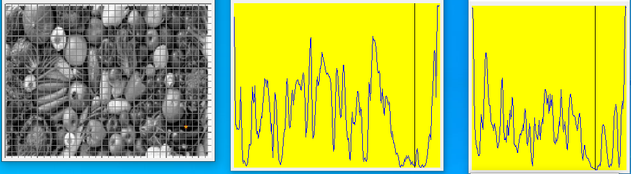
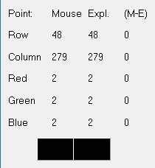
21.11 – A212.bmp image and its profiles (row and column)
– for a certain point (48,279)
This value is lower than the previous grayscale values of 4 and 31, indicating the Min-Max algorithm has adjusted the intensity to a very low level at this point.
location
A212.bmp
Row Profile (Row = 48):
The profile for row 49 shows significant variation in intensity values. Peaks and valleys indicate regions of varying intensity along this row. The overall intensity is generally lower compared to the original grayscale profile. The Min-Max algorithm has stretched the intensity values to span a wider range, resulting in a more pronounced dynamic range.
RGB values
Column Profile (Column = 279):
The column profile follows a similar pattern to the row profile, showing varying intensity values. The peaks and valleys indicate changes in intensity along this column, similar to the row profile.

Slide 17
21.12 – comparison of the results – for a certain point (48,279)
A201gray.bmp
Original gray image (without further manipulation)
(4,4,4)=R,G,B
A2111.bmp
Both for the point (48,279)
With spoiled_Image algorithm
(31,31,31)=R,G,B
A2121.bmp
With min_max_algorithm
(2,2,2)=R,G,B

Slide 18
21.13 What did we learned
We learned how to implement algorithms and functions that deals with image properties such as: contrast & brightness.
2) We learned how to find the optimal outcome of an image using mathematical way so the image will look the best.
3) We used, practiced and implemented methods involving LUT which is an essential concept in Image Processing

